Slide 1
^{SCENARIO}

Slide 2

eBusiness Development
^{DIVING INTO BDD: HOW WE DO IT}
www.nfq.com

Slide 3
^{IN ORDER TO}
To exchange knowledge
To share our best practices

Slide 4
^{AS A}
Darius Kasperavičius
Karolis Daužickas
Irmantas Zenkus

Slide 5
^{WE WANT TO}
To do the presentation

Slide 6

Acceptance testing

Slide 7
^{TESTING}
TESTS REDUCE BUGS
TESTS ARE GOOD DOCUMENTATION
TESTS ALLOW SAFE REFACTORING TESTS
REDUCE THE COST OF CHANGE TESTING
FORCES YOU TO THINK
Notes:
Black Box White Box Unit Integration Functional System Regression Performance Smoke Canary Usability A/B Characterization tests
...
A study conducted by Microsoft and IBM showed that writing tests can add 15% – 35% to development time but reduce the number of bugs by 40% – 90%

Slide 8
^{BDD}
BDD (Behaviour Driven Development) is a synthesis and refinement of practices stemming from TDD (Test Driven Development) and ATDD (Acceptance Test Driven Development).

Slide 9
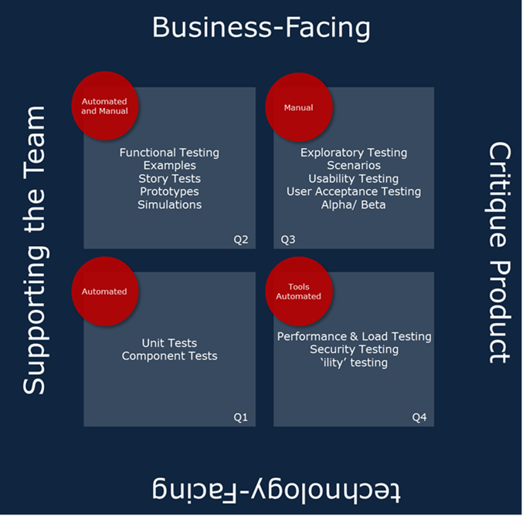
Notes:
Q2Q3 Validate
Q1Q4 Verify
Q2q1 For the team
Q3Q4 For the Customer

Slide 10
^{STORY}
BDD (Behaviour Driven Development) is a synthesis and refinement of practices stemming from TDD (Test Driven Development) and ATDD (Acceptance Test Driven Development).

Slide 12
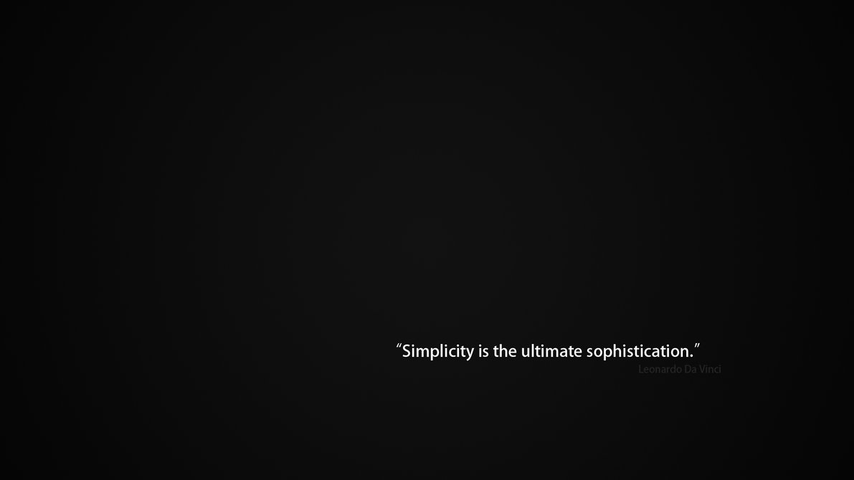
Simplicity is the ultimate sophistication

Slide 13
^{BDD MYTHS}
BDD (Behaviour Driven Development) is a synthesis and refinement of practices stemming from TDD (Test Driven Development) and ATDD (Acceptance Test Driven Development).
Notes:
Behaviour-driven development is an “outside-in” methodology. It starts at the outside by identifying business outcomes, and then drills down into the feature set that will achieve those outcomes
Behaviour-driven development (BDD) takes the position that you can turn an idea for a requirement into implemented, tested, production-ready code simply and effectively, as long as the requirement is specific enough that everyone knows what’s going on

Slide 14
^{INSTOOLATION}

Slide 15

^{BDD IN}

Slide 16
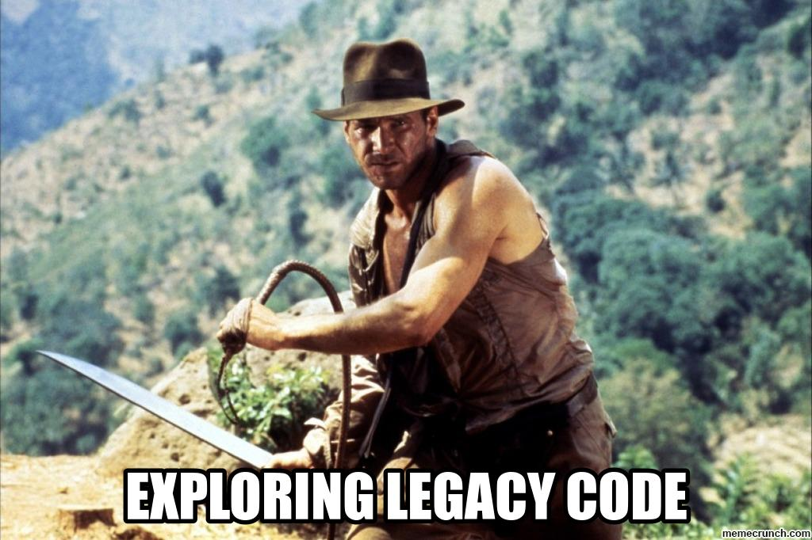
Notes:
Component based Engineering vs Legacy

Slide 17
^{BEHAT}
Behat is an open source behavior-driven development framework for PHP 5.3 and 5.4.
What is behavior-driven development, you ask? It’s the idea that you start by writing human-readable sentences that describe a feature of your application and how it should work, and only then implement this behavior in software.

Slide 18
We are not testing that application functions as we (developers) expect it to, but instead we’re testing that it fullfils clients business needs.
Behat by example by Konstantin Kudryashov

Slide 19
You might think about Behat as a tool to teach your clients about testing, but in reality it's a tool to teach you about client business.

Slide 20
^{BEHAT VS PHPSPEC}
External
Internal
Behat deals to have specifications that reflects the environment from the outside.
PHPSpec responds to the behaviour in the lower level, from the internal of the classes.
PHPSpec is considered a tool that helps you to develop.

Slide 21
BEHAT INSTALATION
"require-dev": {
"behat/behat": "3.*@stable",
"behat/mink-extension": "*”,
"behat/mink": "1.5@stable",
"behat/mink-selenium2-driver": "*",
"behat/common-contexts": "*@dev",
"phpunit/phpunit": "4.*@stable",
"sensiolabs/behat-page-object-extension": "dev-master",
"ocramius/proxy-manager": "~0.5"
}
composer update
bin/behat --init

Slide 22
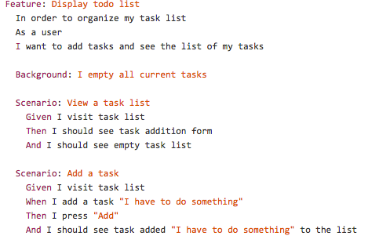
BEHAT EXAMPLE
Gherkin

Slide 23
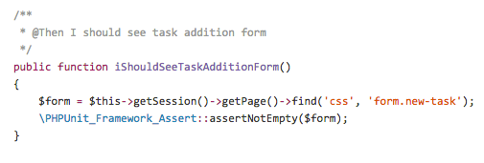
BEHAT EXAMPLE
FeatureContext
Notes:
the context class is all about how to test your application, and that it actually behaves as expected

Slide 24
BEHAT 3: WHAT’S NEW?
Implements SnippetAcceptingContext
Turnip mathching (@Given My name is :name). Regex is still supported.
Output in code
Cleaner and more structured output (shows exactly wher it failed)
Error out levels

Slide 25
TIPS

Slide 26
USE MULTIPLE CONTEXTS
public function __construct(array $parameters)
{
$this->useContext('subcontext_alias', new AnotherContext());
}

Slide 27

USE SYMFONY2EXTENSION

Slide 28
USE PAGEOBJECT BUNDLE

Slide 29
USE EXTERNAL ASSERTATION TOOL
PhpUnit / PhpSpec

Slide 30
^{QUESTIONS?}

Slide 31
Resources
http://dannorth.net/introducing-bdd/
http://dannorth.net/whats-in-a-story/
http://alistair.cockburn.us/Use+case+fundamentals
http://everzet.com/post/35632192627/great-talk-about-why-newcomers-get-bdd-wrong
http://dannorth.net/2012/05/31/bdd-is-like-tdd-if/
http://welcometothebundle.com/it-is-all-about-behaviour-also-in-php/
http://welcometothebundle.com/best-resources-about-symfony-tdd-bdd-ddd-methologies/
http://www.agile-doctor.com/2012/03/06/10-reasons-why-bdd-changes-everything/
https://github.com/Behat/en-mink.behat.org/blob/master/index.rst#find-methods
http://guide.agilealliance.org/guide/bdd.html
http://vimeo.com/43612884
http://welcometothebundle.com/phpunit-vs-phpspec-theory-on-behaviour-driven-development/
http://elephantintheroom.io/blog/2013/11/episode-5-test-first-after-and-beyond/
https://speakerdeck.com/everzet/behat-by-example
Darius K.

